Slide 1
«Приемы формирования осознанного чтения у младших школьников на уроках иностранного языка» учитель: Романова Т.С.

Slide 2
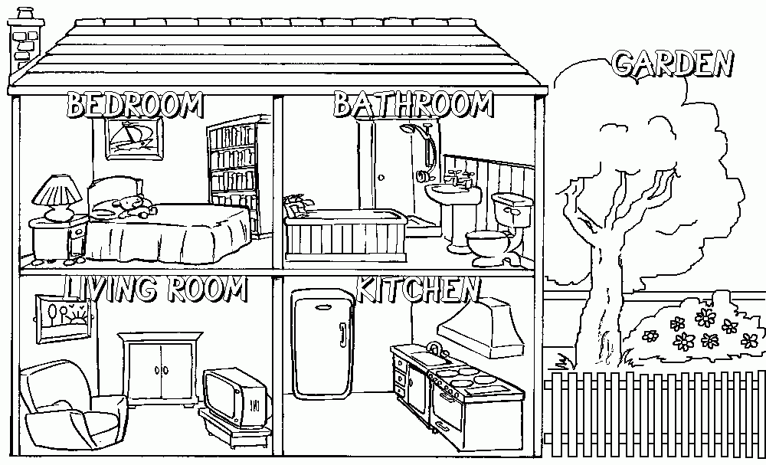
This is Mr Hill’s house. It’s not big but nice. There are 4 rooms in his house. There’s a green bedroom and blue bathroom in this house. There’s a yellow lamp and a red bed in his bedroom. There’s a cat in the bedroom. His kitchen is orange. There’s a black dog in the kitchen. His living room is green. There’s a spider in the living room. His garden is big. There’s a butterfly in the garden. There’s a big green tree in the garden.
Прочитай текст, дорисуй животных, о которых там рассказывают.
Обрати внимание на цвета комнат и предметов, раскрась их.

Slide 3
This is Mr Hill’s house. It’s not big but nice. There are 4 rooms in his house. There’s a green bedroom and blue bathroom in this house. There’s a yellow lamp and a red bed in his bedroom. There’s a cat in the bedroom. His kitchen is orange. There’s a black dog in the kitchen. His living room is green. There’s a spider in the living room. His garden is big. There’s a butterfly in the garden. There’s a big green tree in the garden.

Slide 4
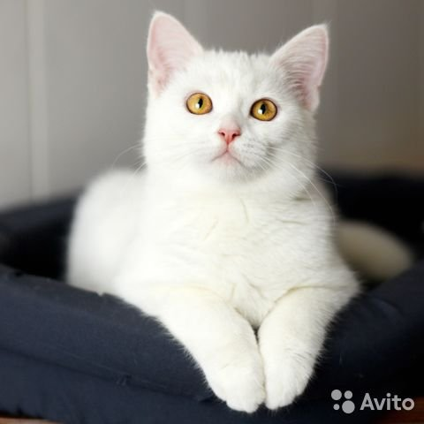
Предтекстовые задания
What is this?
It is a cat!
What colour is the cat?
It is white

Slide 5
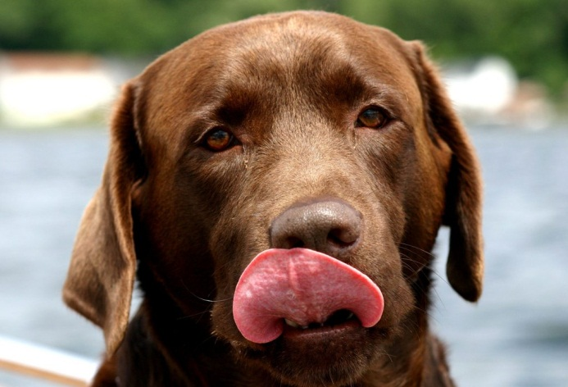
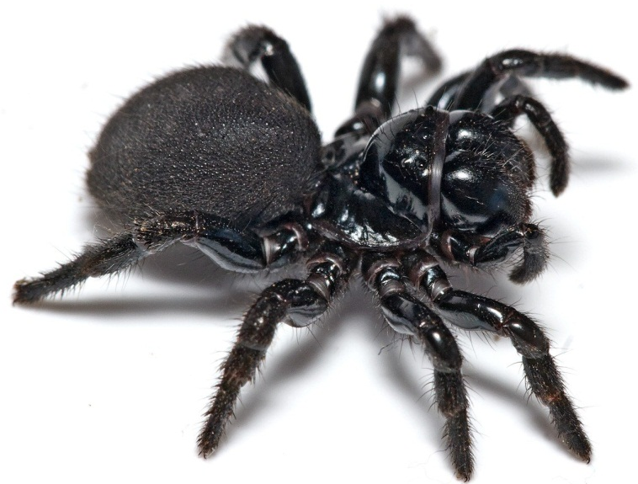
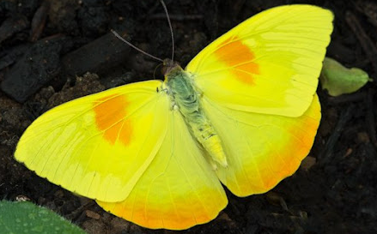
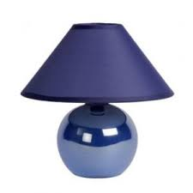
What is it?
— It is a dog!
What colour is the dog?
— It is brown
What is it?
— It is a spider!
What colour is the spider?
— It is black
What is it?
— It is a butterfly!
What colour is the butterfly?
— It is yellow
What is it?
— It is a lamp!
What colour is the lamp?
— It is blue

Slide 6
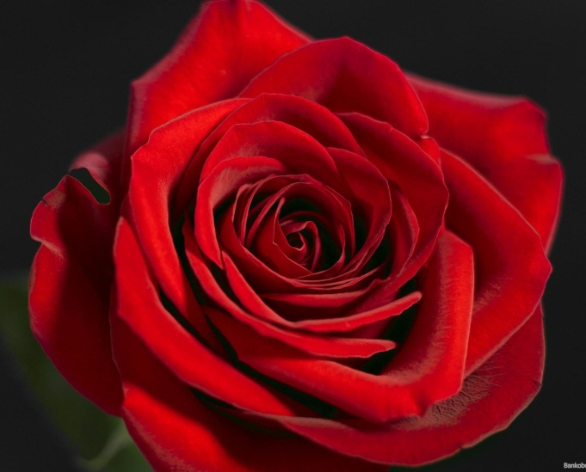
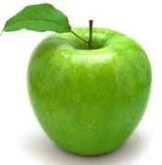
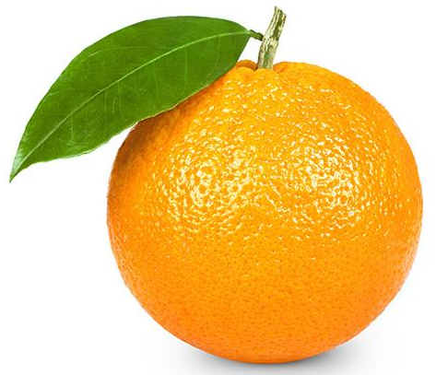
What is it?
— It is a rose!
What colour is the rose?
— It is red
What is it?
— It is a apple!
What colour is the apple?
— It is green
What is it?
— It is a orange!
What colour is the orange?
— It is orange

Slide 8
True or False
There’s a spider in the bathroom. ____
There's a cat in the bedroom. ____
There's a bird in the living room. ____
There's a bee in the kitchen. _____
There's a dog in the hall. _____
There’s a butterfly in the garden.___

